Slide 1
DOG BREED CLASSIFICATION USING CNN
Prof. Harith Yanam
Team:
Sree Nandha (QX54175) &
Saroj Kumandan (EI34057)

Slide 2
TABLE OF CONTENTS
Project Description & Problem Statement
Dataset Overview
Project Workflow
Data Collection & Preprocessing
Model Development
Model Architecture
Training & Evaluation
Visualizations
Observations
Conclusion

Slide 3
PROJECT DESCRIPTION & PROBLEM STATEMENT
Project Description -
Developed an image classification system to identify dog breeds.
Utilized big data tool such as PySpark and Tensorflow.
Enhanced for veterinary care and supported pet adoption processes.
Manual dog breed identification is error-prone.
Misidentification can lead to inadequate care and adoption mismatches.
Need for a reliable system leveraging machine learning and big data technologies.
The solution should scale to handle large datasets efficiently.

Slide 4
DATASET OVERVIEW
Dataset sourced from the Stanford Dogs Dataset.
Contains images of dogs labelled by breeds.
Includes a CSV file and JPG image files.
The dataset comprises images from 120 different breeds.
The dataset contains approximately 20,500 images, with each dog breed represented by around 150 to 250 images.

Slide 5
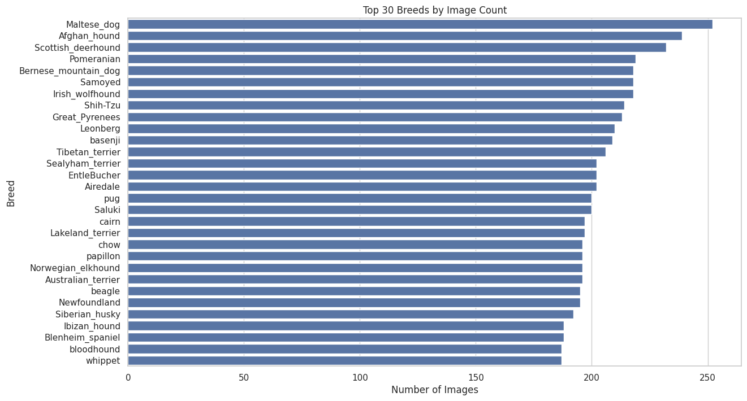
DATASET OVERVIEW

Slide 6
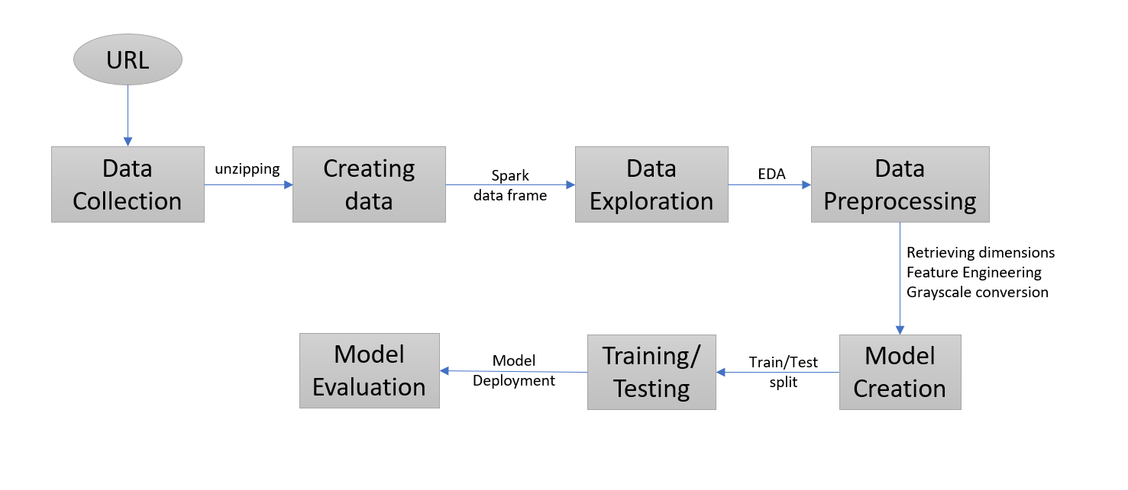
PROJECT WORKFLOW

Slide 7
DATA COLLECTION & PREPROCESSING
DATA COLLECTION:
Retrieved data from URL using request
Unzipped the file using tarfile
Debugging was performed to check the data collection
File paths of the images were stored in a spark data frame
PREPROCESSING:
Further data cleaning and preprocessing with PySpark.
Using Pyspark we got dimensions using UDF and added features like height, width and height-width ratio
Standardized image sizes and formats for consistency.
Converted to grayscale

Slide 8
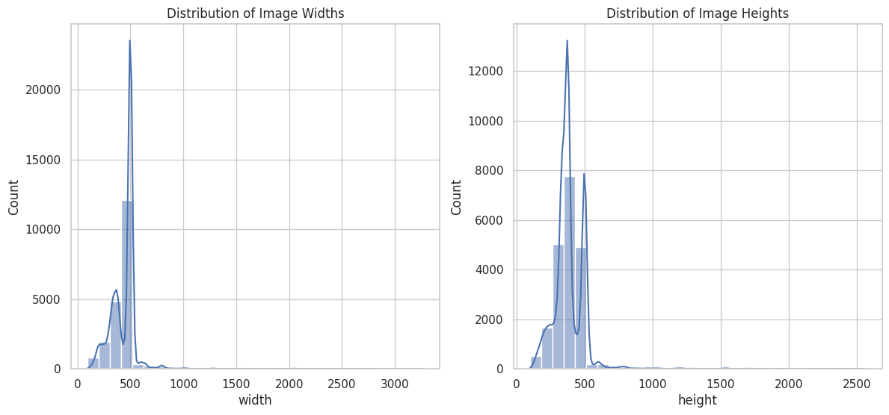

Slide 9
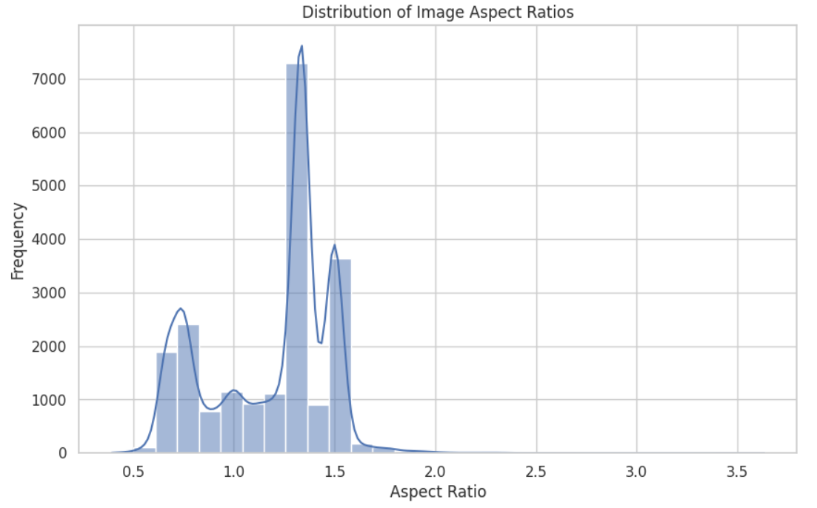

Slide 10
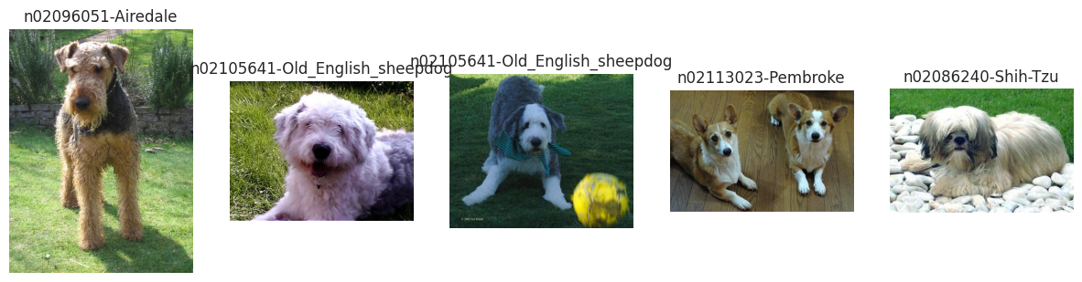
DATA PRE-PROCESSING
Resized images to a consistent shape.
These are some of the sample images.

Slide 11
MODEL DEVELOPMENT
Developed a Convolutional Neural Network (CNN) for image classification.
Utilized transfer learning with the Sequential model.
Model architecture was designed to learn from thousands of images across numerous dog breeds
The model contains 5 (Conv2D) and MaxPooling2D layers, followed by a Dropout layer, designed for effective feature extraction and dimensionality reduction.
The model ends with a Dense layer for classification, In total, this architecture consists of 19 layers, specifically tailored for processing and classifying images of dog breeds.

Slide 12
MODEL ARCHITECTURE
CNN Architecture
Bullet Points:
Layers: Conv2D, MaxPooling2D, Dropout, Dense, Flatten.
Activation function: ReLU.
Output layer: Softmax for classification.
Batch normalisation layers to improve training stability.
The data has been split into an 80:20 ratio for training and testing, with 14,406 images allocated to the training set and 6,174 images to the testing set.

Slide 13
TRAINING & EVALUATION
TRAINING THE MODEL
Trained the model on a large dataset.
Progressive validation and tuning to improve accuracy.
(callbacks) Early stopping and checkpointing to prevent overfitting.
Used learning rate scheduling to optimize training.
We ran 100 epochs for training, with each epoch taking approximately 3 seconds to execute.
EVALUATION
Evaluated model using accuracy rates
Predictions were made to check that the model runs accurately

Slide 14
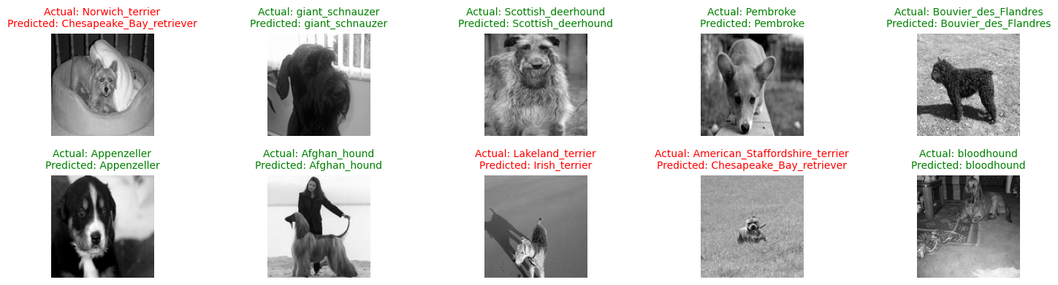
TESTING MODEL

Slide 15
RESULTS
Over the course of training our model for 100 epochs, we observed the following performance in the final 5 epochs. The training accuracy improved from 76.36% to 79.26%, while the validation accuracy started at 85.50%, fluctuated, and ended at 78.80%.
After training on 14,406 images, the model's performance was evaluated on the test set, resulting in a test loss of 0.7593 and a test accuracy of 78.80%.
Training accuracy: 79.26%
Testing accuracy: 78.80%
Test Loss: 0.7593

Slide 16
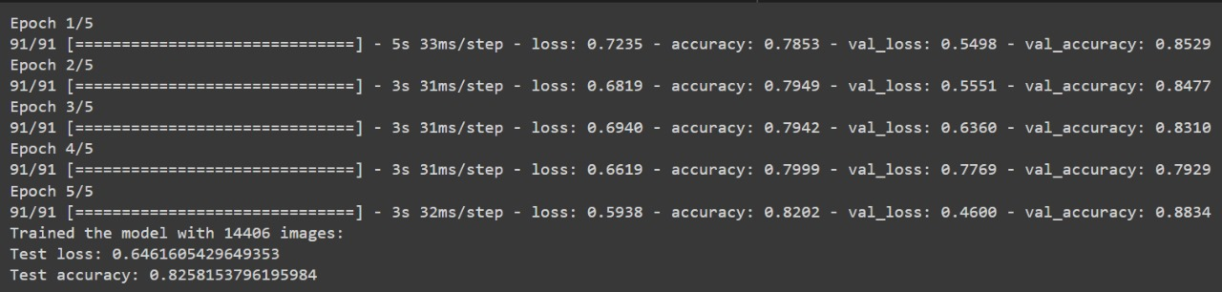
RESULTS

Slide 17
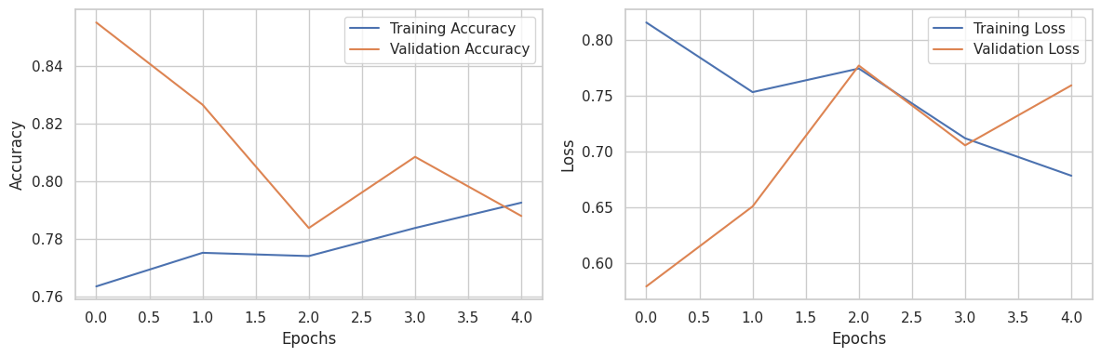

Slide 18
OBSERVATIONS
Accuracy improved with a larger dataset size.
Out of 10 test samples, the model made 7 correct predictions (70% accuracy) and incorrectly classified 3 samples (30% misclassification rate)
After training on 14,406 images, the model achieved a test loss of 0.7593 and a test accuracy of 78.80%.
The results suggest areas for further tuning and improvement, despite the model's overall strong performance with more data.

Slide 19
CONCLUSION
Our CNN for dog breed classification used 20,500 images, split into 14,406 for training and 6,174 for testing. Training over 100 epochs improved accuracy significantly with larger datasets.
The model achieved a test accuracy of 82.58% and a test loss of 0.6461. On a subset of 10 test samples, it correctly classified 7 (70% accuracy) and misclassified 3 (30% misclassification rate), highlighting areas for improvement.

Slide 20
CONCLUSION
This project demonstrated the effectiveness of CNNs for dog breed classification, with future work focusing on data augmentation, hyperparameter tuning, and advanced architectures.

Slide 21
THANK YOU

